Slide 1
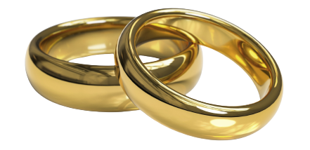
Chemical changes
Atom
The smallest particle of matter, which all things are made of.
Element
A pure substance that is made of only one type of atom. All atoms of an element are identical, e.g. Gold is an element made up of gold atoms only. The 118 known elements are listed on the periodic table of elements.
The atoms of some elements do not join together, but instead they
stay as separate atoms, e.g. helium.
helium
a single atom
oxygen
The atoms of other elements join together to make molecules,
e.g. oxygen and hydrogen.
hydrogen
Properties of elements
Individual atoms do not have the properties of the element. The properties of an element are because of the arrangement and behaviour of the atoms as a group.
Metals | Non-metals
most are shiny | most are dull
most are hard | solid non-metals are soft and easy to cut, except carbon as diamond
most are strong | most are not strong
most are sonorous (makes a ringing sound when hit) | most are not sonorous
malleable (easy to reshape without breaking) | not malleable
most are ductile (can be drawn out into a long wire without breaking​​) | not ductile
most have very high melting and boiling points | most have very low melting and boiling points
some but not all are magnetic | not magnetic
conduct electricity | non-metals do not conduct electricity, except carbon as graphite
good at conducting heat | poor at conducting heat
Writing element symbols
Na
O
The first letter is always written as a capital letter and if there is a second letter, it is always written as a lowercase letter.
Element symbols make writing elements easier and allow scientists all over the world to communicate and write about them.
sodium
oxygen
Science | 7.04 – Chemical changes | Knowledge Organiser
Notes:
Images:
Ring (CC0) - https://www.rawpixel.com/image/6295066/png-sticker-golden
All other images – United Learning

Slide 2
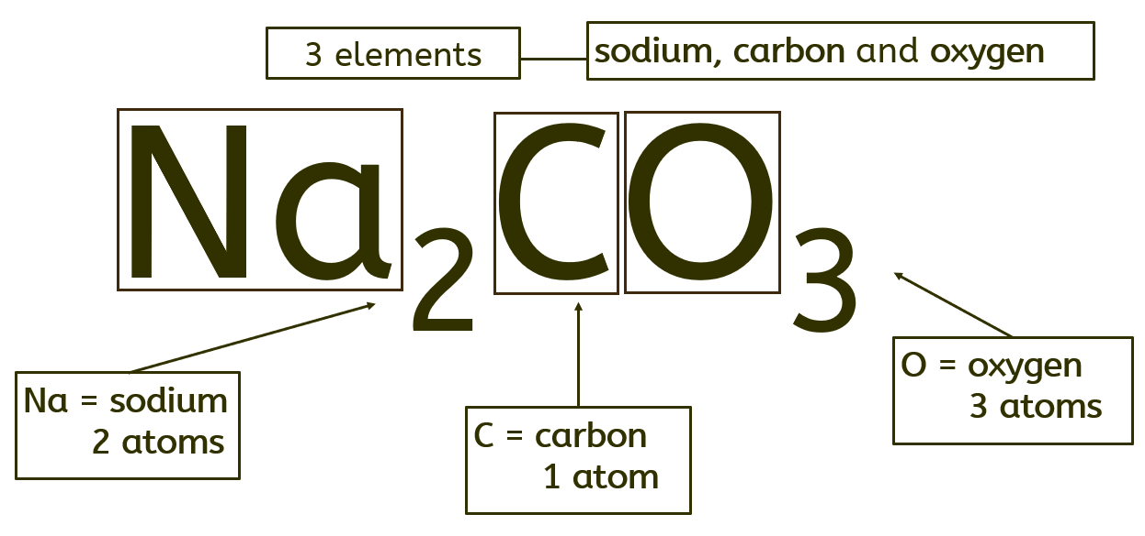
Chemical changes
Compound
A substance made of two or more different elements chemically joined (bonded) together.
A chemical bond is a strong force that holds atoms together in a compound. Lots of energy is
needed to break a chemical bond. A compound cannot be easily separated.
different atoms
(hydrogen and oxygen)
A compound may have very different properties to those of the elements from which it is made.
Water is a compound of hydrogen and oxygen.
Each of its molecules contains two hydrogen atoms and one oxygen atom.
water
Chemical formulae
Chemical reactions
A chemical formula uses chemical symbols and numbers to show how many of each atom is present in a compound.
The small numbers (subscript) go at the bottom.
For example:
CO₂ is correct;
CO2 and CO² are wrong.
The formula for sodium carbonate is Na₂CO₃. It tells you that sodium carbonate contains two sodium atoms (Na x 2), one carbon atom (C) and three oxygen atoms (O x 3).
When chemicals
react, the atoms
are rearranged.
For example, iron
reacts with sulfur to
make iron sulfide. Iron sulfide, the compound formed in this reaction, has different properties to the elements it is made from.
+
→
different atoms
(iron and sulfur)
iron
sulfur
iron sulfide
 | iron | sulfur | iron sulfide
Type of substance | element | element | compound
Colour | silvery grey | yellow | black
Is it attracted to a magnet? | yes | no | no
Conservation of mass
Atoms are not destroyed nor created during chemical reactions, so in any reaction:
Total mass of reactants = total mass of products
Naming metal and non-metal compounds
The metal element (furthest left on the periodic table) comes first in the name of the compound. The ending for the non-metal is shortened and changed to ‘–ide’. E.g. iron + sulfur → iron sulfide
Naming three element compounds containing oxygen
The metal element (furthest left on the periodic table) comes first in the name of the compound. If there are three elements in the compound, and
one of them is oxygen, the ending of the non-metal is shortened and changed to ‘–ate’. E.g. lithium + nitrogen + oxygen → lithium nitrate
Science | 7.04 – Chemical changes | Knowledge Organiser
Notes:
Images:
All images – United Learning

Slide 3
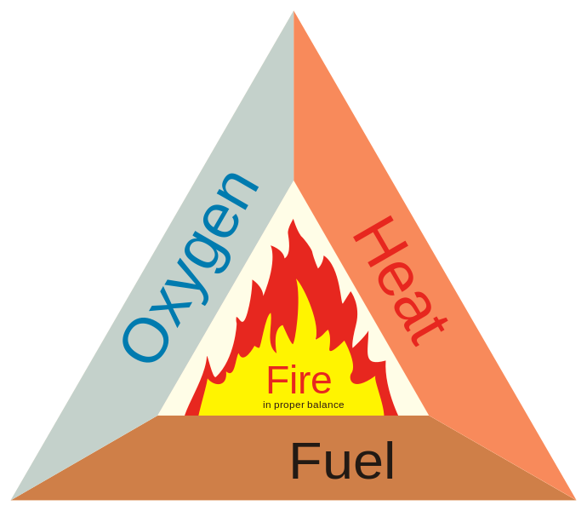
Chemical changes
Chemical equations
Oxidation reactions
Thermal decomposition reactions
We summarise chemical reactions using equations:
reactants → products
Reactants are shown on the left of the arrow;
Products are shown on the right of the arrow.
Do not write an ‘=‘ sign instead of an arrow.
If there is more than one reactant or product, they are separated by a ‘+’ sign. For example:
copper + oxygen → copper oxide
Reactants: copper and oxygen
Products: copper oxide
A word equation shows the names of each substance involved in a reaction and must not include any chemical symbols or formulae.
In oxidation reactions, a substance gains oxygen. Metals and non-metals can take part in oxidation reactions (be oxidised).
Another example is a combustion reaction, where we burn fuels in oxygen:
Fuel + oxygen → carbon dioxide + water
methane + oxygen → water + carbon dioxide
Combustion is another name
for burning fuels.
It is an exothermic reaction.
The fire triangle shows three
components which, when
combined, provide the right
conditions for combustion
to happen.
This is the breaking down of a substance, using heat, to form two or more products. It is an endothermic reaction.
Many metal carbonates take part in thermal decomposition reactions. For example, copper carbonate:
Magnesium reacts with oxygen to form magnesium oxide:
magnesium + oxygen → magnesium oxide
2Mg(s) + O₂(g) → 2MgO(s)
copper carbonate is green; copper oxide is black.
copper carbonate → copper oxide + carbon dioxide
CuCO3(s) → CuO(s) + CO₂(g)
Carbon reacts with oxygen to form
carbon dioxide:
carbon + oxygen → carbon dioxide
C(s) + O₂(g) → CO₂(g)
Exothermic and Endothermic reactions
Exothermic reaction - transfers energy to the thermal store of the surroundings. This causes a rise in temperature (positive temperature change).
Hand warmers transfer energy to the thermal store of the surroundings by an exothermic oxidation reaction.
Endothermic reaction – transfers energy in from the thermal store of the surroundings. This causes a drop in temperature (negative temperature change).
Sports injury packs transfer energy from the thermal store of the surroundings by an endothermic reaction.
Temperature data collected from exothermic and endothermic reactions can be improved by:
Using a polystyrene cup as an insulator, as it reduces energy transfers to or from the surroundings.
Using a lid to reduce energy transferred from the surface.
Using a digital thermometer, which is easier to read than a regular thermometer and, if it measures in decimal places, also has better resolution.
State symbols in chemical formulae provide information about the physical state of the reactants and products.
(s) – solid , (l) – liquid, (g) – gas, and (aq) – aqueous solution (i.e. dissolved in water).
The state symbol comes after the chemical formula and is written in lower case and in brackets. E.g. CuCO₃(s) → CuO(s) + CO₂(g)
Science | 7.04 – Chemical changes | Knowledge Organiser
Notes:
Images:
Fire triangle (“Fire_triangle_2.svg” (CC BY-SA 3.0) by derivative work: Dch (talk)Verbrennungsdreieck.svg:Stefan-Xp) - https://commons.wikimedia.org/wiki/File:Fire_triangle_2.svg

